Slide 1
Full Stack Application Development
Application Development- Introduction
Web application architectures
MVC
Akshaya Ganesan

Slide 2
Model-View Controller
Variations of MVC

Slide 3
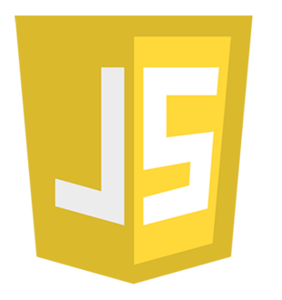
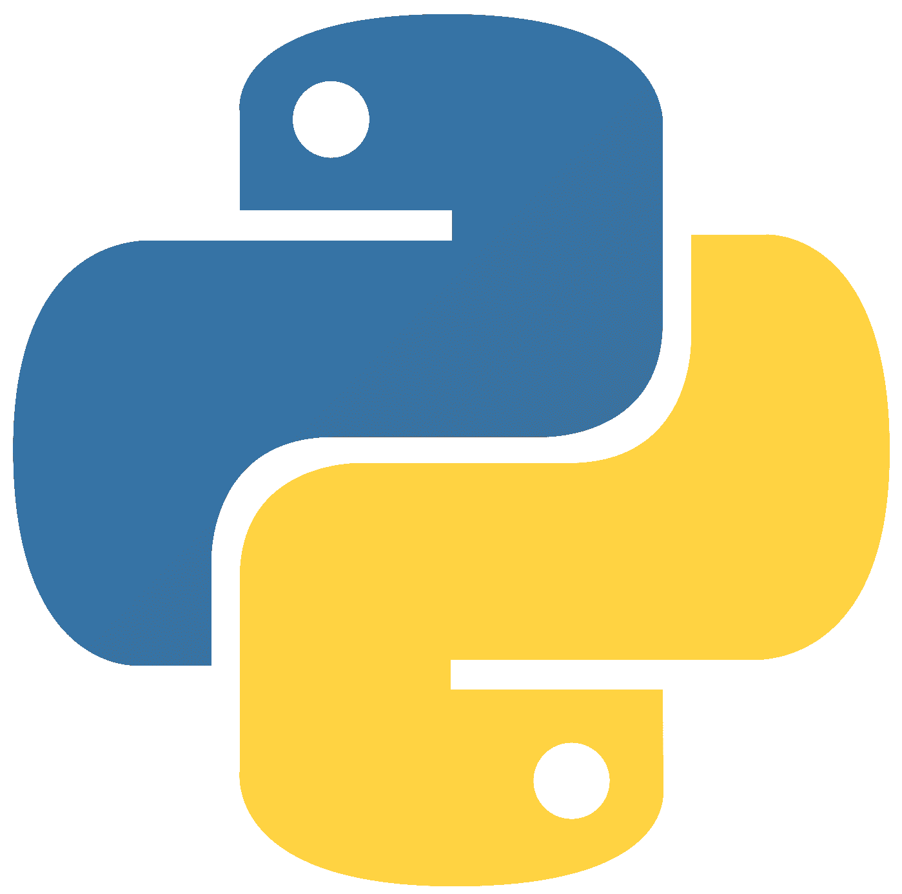



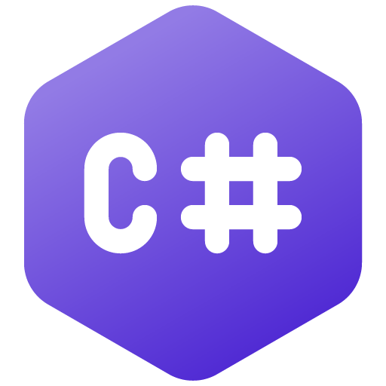
Model View Controller (MVC)
Software design pattern commonly used for developing user interfaces that divides the related program logic into three interconnected elements.
Supported well in JavaScript, Python, Ruby, PHP, Java, C#.
Three main logical components:
The model,
The view, and
The controller.
Separates functionality.
Promotes organized programming.

Slide 4
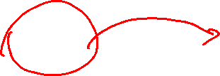
Model View Controller (MVC)
Separating the presentation from the model and
Separating the controller from the view.
Browser
View
Controller
Model
Database

Slide 5
Model
Data related Logic
Interacts with the Database
Communicated with controller
Updates view (on few Frameworks)

Slide 6
View
User Interface
Communicates with controller
Template engines
Implementing the view in MVC
Template View and
Renders information into HTML by embedding markers in an HTML page.
Transform View
writing a program that looks at domain-oriented data and converts it to HTML.

Slide 7
Controller
Receives input( from view)
Process request( GET, POST)
Gets data from the model
Pass data to view
Load a plain view(static HTML pages)
Implementing Controller
Page controller
Front controller
Application controller

Slide 8
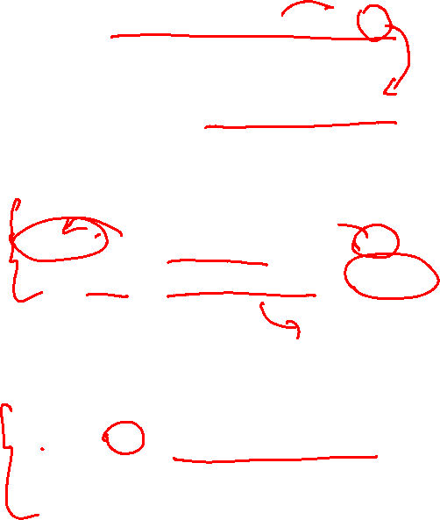
Example
http://mywebsite/users/profiles/1
/routes
Users/profiles/id = Users.getUser(id)
/controllers
Class Users{
function getUser(id){
Profile=this.UserModel.getUser(id)
renderView(“/users/profiles”, profile)
}
}
/Models
Class UserModel{
getUser(id){ sql query to db , return data}
}

Slide 9
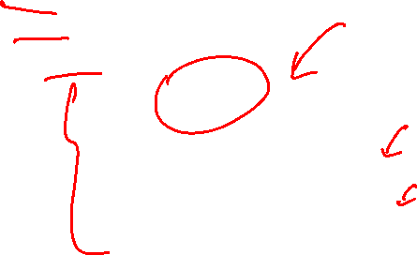
Example
/views
/users
/profile
<h1> {{profile.name}}</h1>
<ul>
<li>email : {{profile.email}}</li>
<li>Phone: {{profile:phone}}</li>
</ul>

Slide 10
Model View Presenter
The view is a passive interface that displays data (the model) and routes user commands (events) to the presenter to act upon that data.
Model
Domain-specific data
Raises events
Manipulates
View
Updates
Presenter
UI and UI events
Formats data for display
Passes calls

Slide 11
MTV (Model, Template, and View)
This Model similar to MVC acts as an interface for your data
The View executes the business logic and interacts with the Model and renders the template.
It accepts HTTP request and then return HTTP responses.
The Template is the component which makes MVT different from MVC.
Templates act as the presentation layer and are basically the HTML code that renders the data.
The content in these files can be either static on dynamic.

Slide 12
Model View Controller and
Its Variants

Slide 13
Thank You!

